Slide 1
Use Visual Studio Code to get started with PowerShell
Steve Peterson,
1800 CONTACTS INC

Slide 2













Sponsors (Please Visit)
GOLD SPONSOR
GOLD SPONSOR
GOLD SPONSOR

Slide 3



Steve Peterson
I have worked in ASP.NET and C# for several years before turning to SQL Server and T-SQL where I have been a SQL Server DBA for over 14 years with a focus on up time and performance.
Certs: MCP MCTS
I like photography, and Lego’s but mostly minifigs…
Twitter: @SQLFitness
Email: speterso@1800contacts.com
https://github.com/SQLFitness/VSCODE_DBA
Notes:
I know its childish to like Lego’s but now I can afford them, so I get them for birthday’s or holiday celebrations.

Slide 4
PowerShell
What is PowerShell?
Why do DBA’s Care?
PowerShell is a task automation and configuration management framework from Microsoft, consisting of a command-line shell and associated scripting language. Initially a Windows component only, known as Windows PowerShell, it was made open-source and cross-platform on 18 August 2016 with the introduction of PowerShell Core. The former is built on .NET Framework while the latter on .NET Core.
-Wikipedia
Notes:
.NET Framework is a software framework developed by Microsoft that runs primarily on Microsoft Windows. It includes a large class library named as Framework Class Library and provides language interoperability across several programming languages. Programs written for.NET Framework execute in a software environment named the Common Language Runtime. The CLR is an application virtual machine that provides services such as security, memory management, and exception handling. As such, computer code written using.NET Framework is called "managed code". FCL and CLR together constitute the.NET Framework.
https://en.wikipedia.org/wiki/.NET_Framework
.NET Core is a free and open-source, managed computer software framework for the Windows, Linux, and macOS operating systems. It is an open source, cross platform successor of.NET Framework. The project is mainly developed by Microsoft and released under the MIT License.
https://en.wikipedia.org/wiki/.NET_Core
The MIT License is a free software license originating at the Massachusetts Institute of Technology (MIT). It is a permissive free software license, meaning that it puts only very limited restriction on reuse and has therefore an excellent license compatibility.
https://en.wikipedia.org/wiki/MIT_License

Slide 5

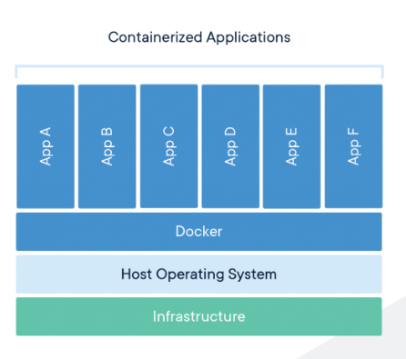
Docker
Docker is a host for containers (sorta like a VM but not)
https://www.docker.com/resources/what-container

Slide 6
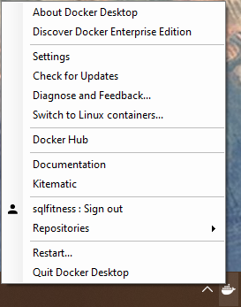
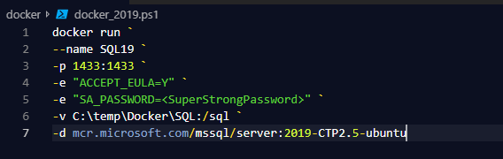
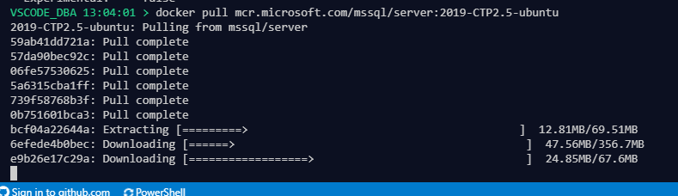
Docker – Side track
I set up a SQL Server docker instance as my databases (dev, staging) this is totally overkill but I wanted to do it because it’s fun to play with new toys. I like whales.
install docker (web)
Switch the architecture to Linux, if you have already switched it to windows after installing it
Turn on the Shared Drive
docker pull mcr.microsoft.com/mssql/server:2019-CTP2.5-ubuntu
Pulling an image just means downloading all the files needed to make the container work.
Run the docker code
Docker start SQL19
Notes:
https://www.cathrinewilhelmsen.net/2018/12/02/sql-server-2019-docker-container/
Based off https://dbafromthecold.com/

Slide 7
PowerShell
Every version of Windows has included a command line interpreter (CLI) for managing the OS.
(rabidly active community)
MS-DOS?!? (the OG CLI)
Windows PowerShell can execute four kinds of named commands:
cmdlets (.NET Framework programs designed to interact with PowerShell)
PowerShell scripts (files suffixed by .ps1)
PowerShell functions
standalone executable programs
Current Version of PowerShell 5.1 (Windows 10)
PowerShell Core 6.0 (Cross platform [open source], mostly expansion to other platforms)
PowerShell Core 6.1 (Expanded to 1900+ CmdLets, significant performance improvements)
PowerShell Core 6.2 (performance improvements)
PowerShell Core 7 (intended to replace 5.1 and 6.2)
Notes:
Cmdlets are specialized commands in the PowerShell environment that implement specific functions. Verb-Noun naming pattern (Get-Help)
Scripts contain and supports variables, functions, branching logic (if-then-else), loops (while, for, do, foreach), structured error and exception handling, closures/lambda expressions and integration with .NET
Functions provide a way to send parameters into a reusable code block
standalone can be run in s separate process.

Slide 8
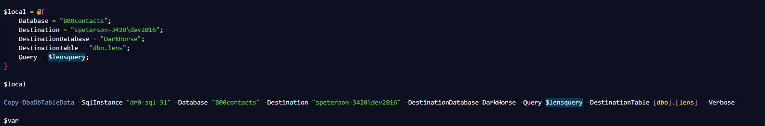
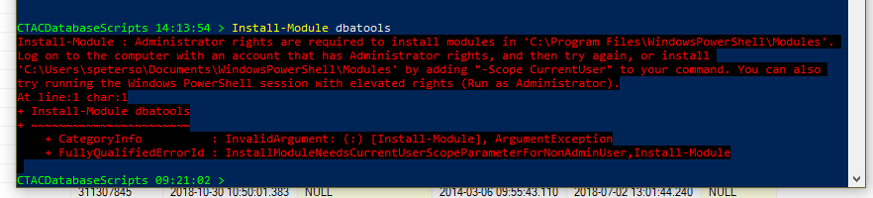
PowerShell basics (all versions)
Profiles – a script that runs whenever you start a new PowerShell session
What can we do, what do you want… DEMO
There are so many… Or are there so many… Why?
Permissions – Security
PS> Install-Module dbatools
PS> Install-Module –Scope CurrentUser
PS> Save-Module dbatools –Path C:\SomeDirectory
Extras
Splatting
Aliases – something can be something else. This isn’t a foreign concept to DBA’s, I would caution against using them often unless it’s a built in to the PowerShell default or company standards, it can get confusing to read someone else’s code.
Notes:
Get-Content $profile
Save-Module dbatools -path c:\temp2 #fail
$newdir = c:\temp\savedmodules #fail
$newdir = "c:\temp\savedmodules“ #success
md $newdir #success
Save-Module dbatools -path $newdir #success
In PowerShell, a “scope” refers to the current environment in which a script or command shell is operating. Scopes are used to protect certain objects within the environment from being unintentionally modified by scripts or functions.

Slide 9

Visual Studio Code
Parts and things…
Buckle UP… Demo Time
Pictures and slides if the network isn’t great.

Slide 10
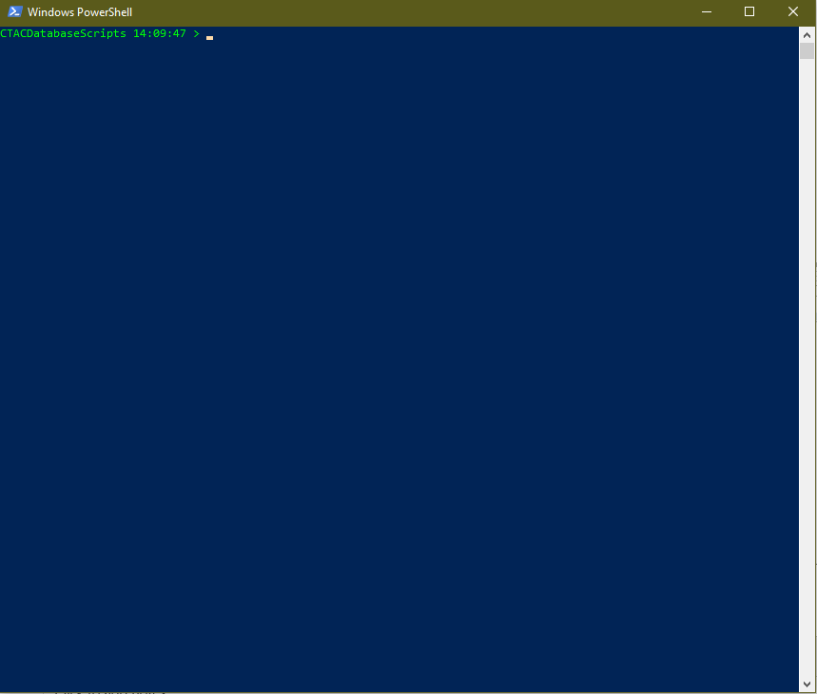
PowerShell (CONT)
It is very confusing for a beginner.
Trust me.
It isn’t as bad as you think.
It’s built on a verb-noun methodology
Get-Help, Get-Help get*, Get-Help Mod
Cls (Clear Screen),
ls (Alias for Get-ChildItem)

Slide 11
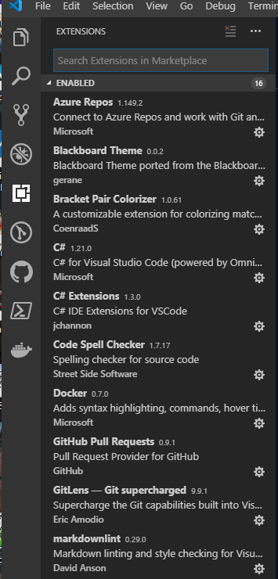
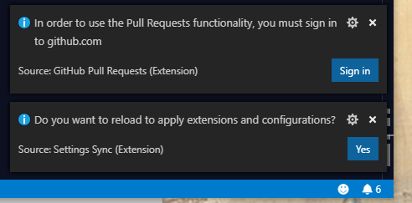
Extensions I have Installed
bracket-pair-colorizer v1.0.61
code-spell-checker v1.7.17
csharp v1.21.0
csharpextensions v1.3.0
gitlens v9.9.1
material-icon-theme v3.8.1
mssql v1.6.0
team v1.149.2
Theme-Blackboard v0.0.2
vsc-material-theme v29.2.0
vscode-docker v0.7.0
vscode-markdownlint v0.29.0
vscode-mysql v0.4.0
vscode-pull-request-github v0.9.1
Notes:
Notice the bell with 6 even though it’s only showing 2, you will need to reload to see the installed extensions

Slide 12
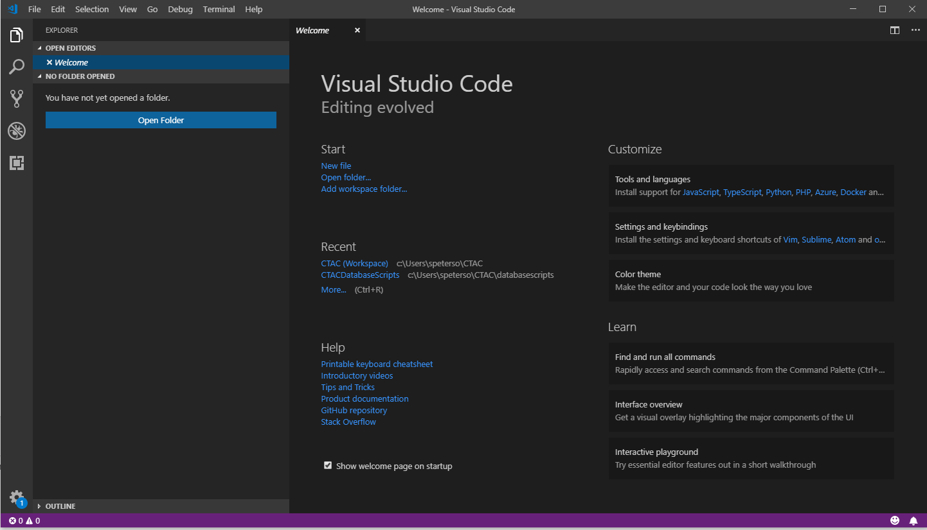
Visual Studio Code
What is Visual Studio Code…
Visual Studio Code is a lightweight but powerful source code editor which runs on your desktop and is available for Windows, macOS and Linux. It comes with built-in support for JavaScript, TypeScript and Node.js and has a rich ecosystem of extensions for other languages (such as C++, C#, Java, Python, PHP, Go) and runtimes (such as .NET and Unity).
Notes:
Installation
1. Download the Visual Studio Code installer for Windows.
2. Once it is downloaded, run the installer (VSCodeUserSetup-{version}.exe). This will only take a minute.
3. By default, VS Code is installed under C:\users\{username}\AppData\Local\Programs\Microsoft VS Code.
You can use a 32-bit version (if you need it… and you are on windows and you are sorta stuck in 2000 or you are a government employee…)

Slide 13
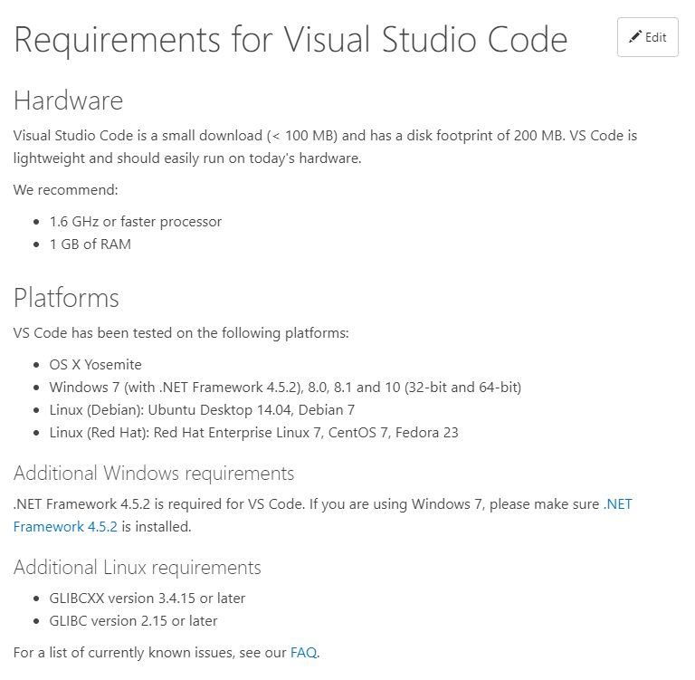
Visual Studio Code (CONT)
Notice the “Edit” button. This site is open source. Just like CODE. The edit button takes you to: https://github.com/Microsoft/vscode-docs/blob/master/docs/supporting/requirements.md
VS Code is updated monthly, prompted with a little number one on the settings gear, you can disable the update check if you want.

Slide 14

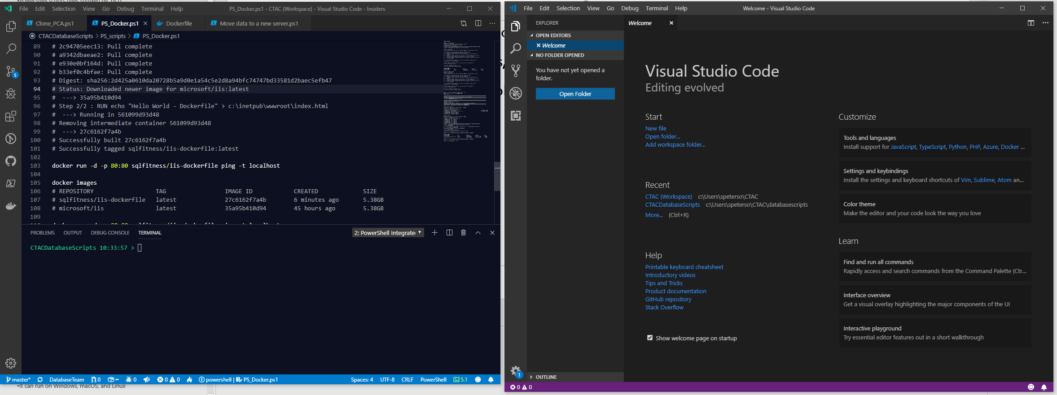
Visual studio Code – Insiders Edition
A developer's version of VS Code.
Nightly updates (new features, verify or early bug fixes)
Side by side installations (stable version of VS Code)
Green for Insiders
Blue for stable version
Same version the VS Code Team uses

Slide 15
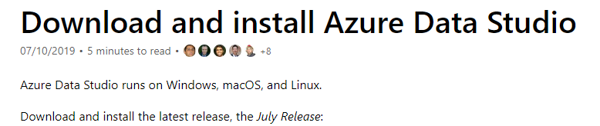
Azure Data Studio
Used to be SQL Operations Studio…
I never used this. Every one that uses brings it up.
I installed this on 7/22/2019…
I have not used it enough to give my opinion.
It can run on Windows, macOS, and Linux
https://docs.microsoft.com/en-us/sql/azure-data-studio/download?view=sql-server-2017

Slide 16
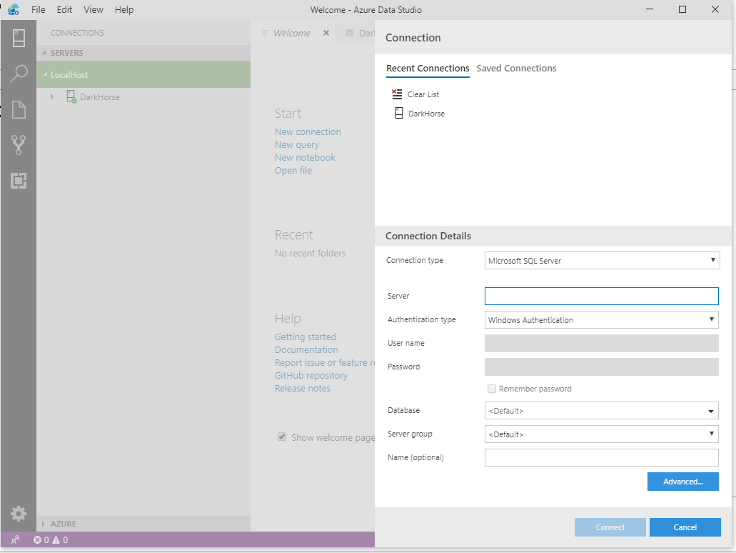
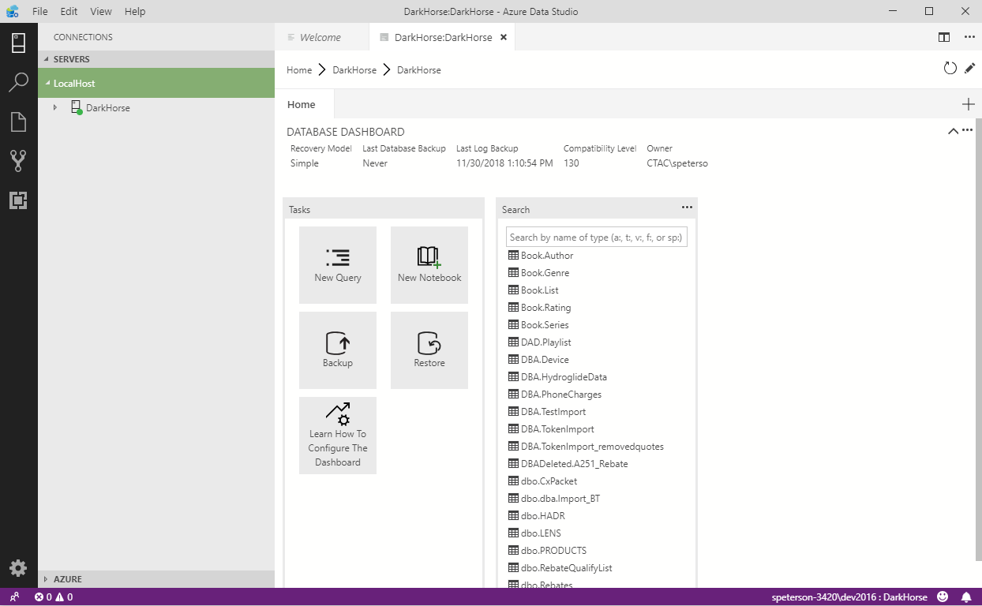
Azure Data Studio (CONT)
Notes:
This is the nicest feature of the Azure Data Studio, it maintains a better list of connections, but is it better then SSMS? I don’t know, I’m not using it.

Slide 17
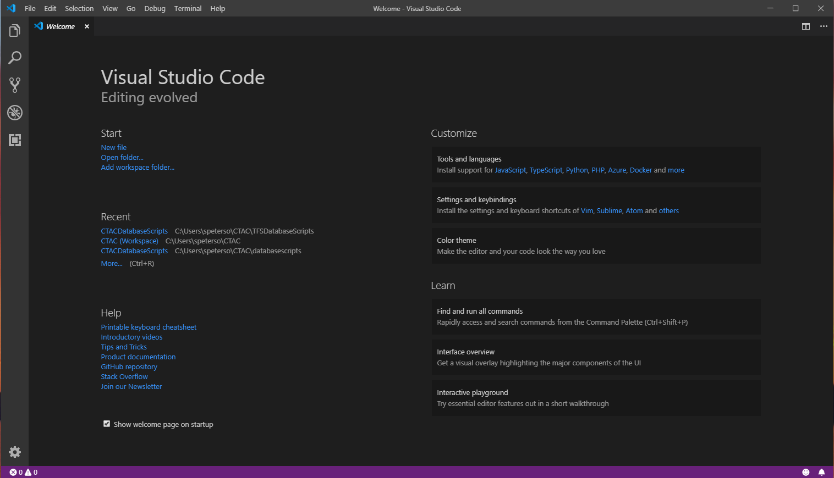
First load
Notes:
Top:
Standard development menu items
But look at the “Help” section, there is an actually useful help to get you started.
Interactive Playground – I know you are going to ignore this because we just want to get started but when you are a few days into the development you can look here for some tips and tricks that will make it so much better.
On the left:
Explore
Search
Source Control – GIT comes installed already
Debug
Extensions
-all the way down-
Settings
Source Control problems… So you are all checking your code, all your code, in to a source control, right?

Slide 18
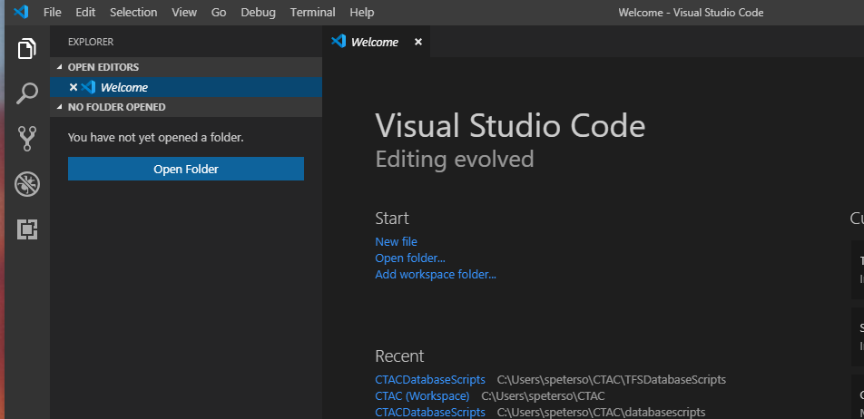
Folders and GIT
Notes:
Notice the open editor and the folder…
If you open a folder that Open Folder button goes away, just go to the file menu and open folder. The current folder will close and the new folder will open.
When you open the folder with a .git folder it is in source control

Slide 19
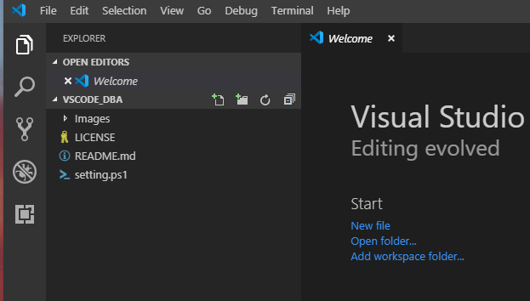
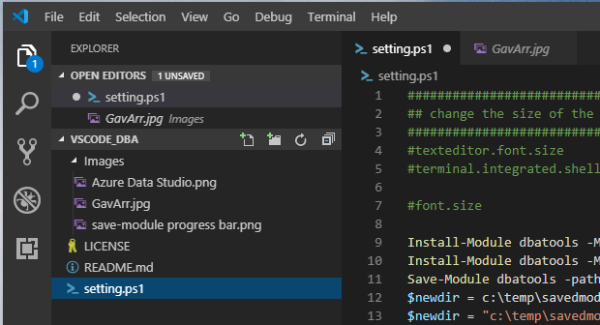
Open editors
Notes:
It took me a lot longer then I would like to admit, to get used to seeing the open editors above the folder structure, like in management studio.
The dot tells you that the file isn’t saved

Slide 20
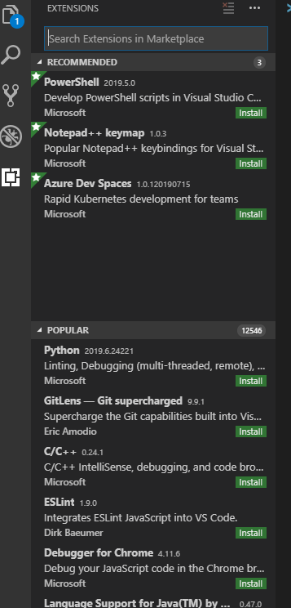
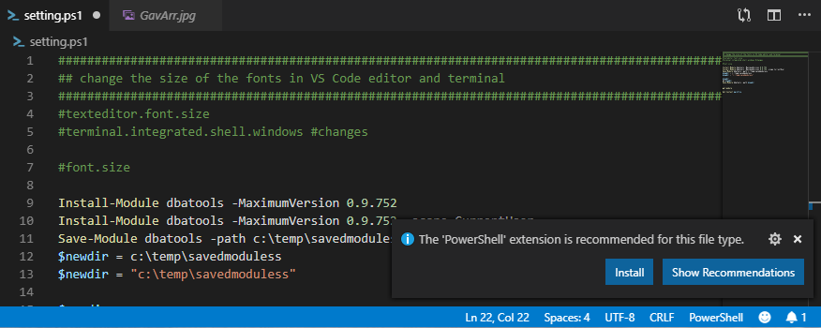
Extensions
Enable additional languages, themes, debuggers, commands, and more. VS Code's growing community shares their secret sauce to improve your workflow.

Slide 21
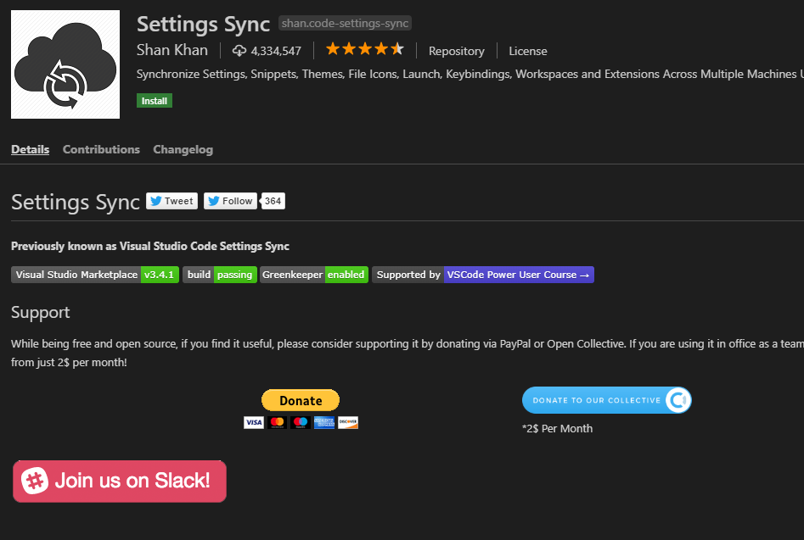
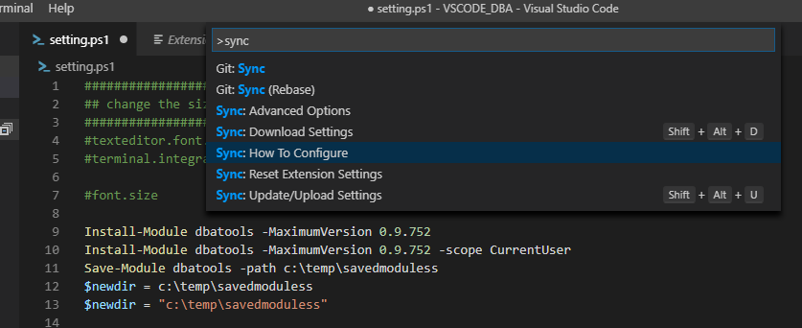
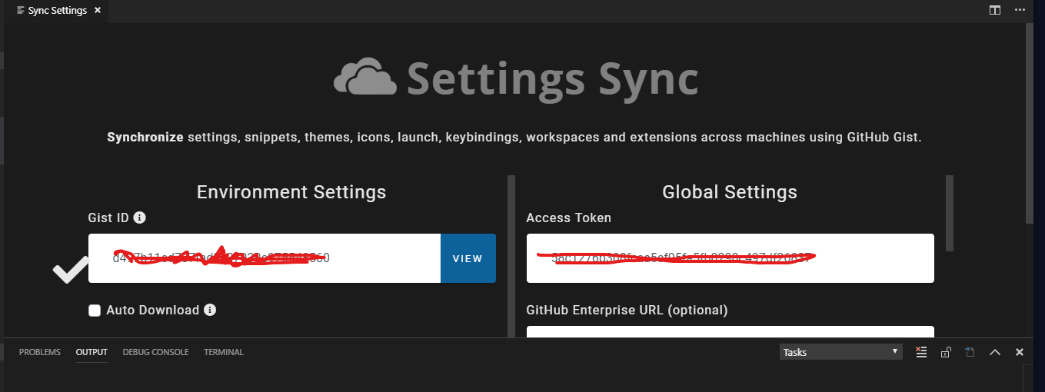
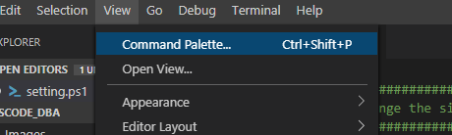
Settings Sync
This is my favorite extension…
Have you ever had to install a new computer and have to remember all the stuff that you have been using for years and forgotten because you only use it like once a month? Then you have to remember where the installer and login and settings are locally or have to go download… yeah I hate that too.
So here is your answer, it uses a GIST key and token to do the work for you… Fingers crossed the demo works it’s awesome!
Notes:
Ctrl+Shift+P then Developer: Reload Window

Slide 22
Questions?
Don’t forget to submit you SQL Saturday Attendance ticket, if you haven’t yet.
Steve Peterson
DBA… Developer?
speterso@1800contacts.com
https://github.com/SQLFitness/VSCODE_DBA

